Slide 1
Open Computer Vision
MUKESH KUMAR

Slide 2
AGENDA
What is OpenCV?
Color Channels (RGB vs BGR)
Image Resizing, Cropping, and Flipping

Slide 3
What is openCV
OpenCV (Open Source Computer Vision Library) is an open-source computer vision and machine learning software library.
It provides a real-time optimized toolkit for processing images and videos.
pip install opencv-python

Slide 4
Applications of OpenCV:
Image processing
Face recognition
Object detection and tracking
Augmented reality
Medical imaging
Industrial inspection
Motion analysis and gesture recognition

Slide 5
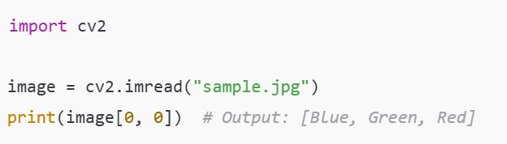
Color Channels (RGB vs BGR)
OpenCV reads images in BGR format by default, while most image processing libraries (like matplotlib) use RGB

Slide 6
Image Data as NumPy Arrays
OpenCV represents images as NumPy arrays, allowing powerful array manipulation.
2D array for grayscale
3D array for color images (height × width × channels)

Slide 7
Image Shape (Height, Width, Channels)
image.shape[0]: Height
image.shape[1]: Width
image.shape[2]: Number of channels (3 for color)

Slide 8
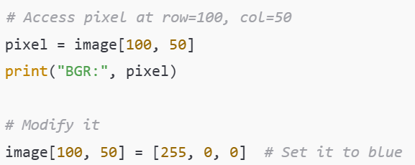
Pixel-Level Access/Modification

Slide 9
Image Resizing, Cropping, and Flipping
Resizing:
resized = cv2.resize(image, (640, 480))

Slide 10
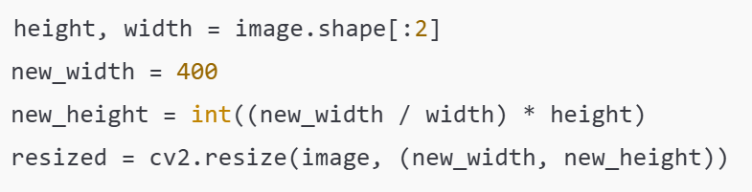
Maintain Aspect Ratio:

Slide 11
Cropping:

Slide 12
Flipping:

Slide 13
Demo

Slide 14
Opening Image Files with OpenCV

Slide 15
cv2.imread(filename, flag)
Flag | Description
cv2.IMREAD_COLOR (or 1) | Loads image in color (default, ignores alpha channel)
cv2.IMREAD_GRAYSCALE (or 0) | Loads image in grayscale
cv2.IMREAD_UNCHANGED (or -1) | Loads image as-is, including alpha channel if present

Slide 16
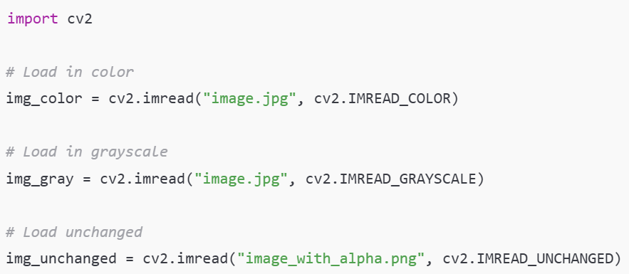

Slide 17

cv2.imshow() – Displaying Images in a Window
Displays an image in a named window. It must be followed by cv2.waitKey().

Slide 18

cv2.waitKey() – Wait for a Key Press
Returns the ASCII code of the key pressed.

Slide 19

cv2.destroyAllWindows() – Close All Image Windows

Slide 20

cv2.imwrite() – Save Image to File
Returns True if the image is written successfully. You can check it for error handling.

Slide 21
Drawing on Images

Slide 22
Why Draw on Images?
Annotate detected objects
Visualize ROI (Region of Interest)
Add labels, arrows, highlights
Useful in image processing, ML model visualization, CV pipelines

Slide 23
Common Drawing Functions in OpenCV
Function | Purpose
cv2.line() | Draw a line
cv2.rectangle() | Draw a rectangle
cv2.circle() | Draw a circle
cv2.ellipse() | Draw an ellipse
cv2.putText() | Add text on an image

Slide 24
Color, Thickness, Line Types
Color: (B, G, R) tuple, e.g. (255, 0, 0) is blue
Thickness: Integer value for border width
Line types:
cv2.LINE_8 – default
cv2.LINE_AA – anti-aliased (smooth lines)

Slide 25
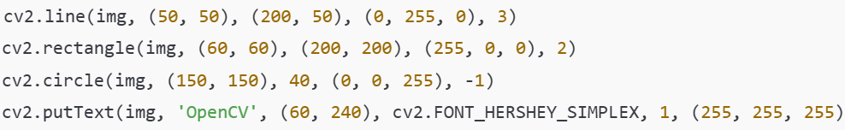
Examples

Slide 26
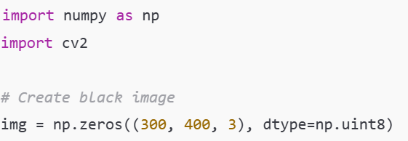
Create a Blank Canvas

